Slide 1
Parking Space Sharing
An App to reduce hassle on road

Slide 2
Inspiration
Dhaka city can provide with less than 1% parking space for more than 0.3 million vehicle which in the main cause for traffic jam in busy areas as well as residential areas, moreover security issue like: raising thievery over recent years in an exponential rate.
So, it can be said that main problem for inadequate parking space are:
Reducing Traffic jam and Road accident.
Ensure security of owners.

Slide 3
Benefits and impacts
The app will provide a low cost, hassle free parking system encouraging people to park in specified parking place.
We will focus on most traffic prone areas by assuring more parking space in those places.
Security will be one of the most prioritize area while developing the app so that the user can feel safe using the service.
It will save time for drivers because they won’t have to look for free space.
The cost will be reasonable so that nobody parks in the street thinking that it will cost them a lot to park in a parking spot.
There will be more walking space as people now tend to park at footpaths.

Slide 4

Existing app on market
What more do we offer?
Flexible - As our proposed system is based on park renter’s registration process, so anyone in the country can register with a free space to rent for any period of time.
Maximum Coverage - It will not be confined in a little area as we believe that it will cover the whole country. And a large number of users will be helpful with this.
Our model will be for all possible types of vehicle. A piece of land owner can register for a big size vehicle.

Slide 5
setbacks
Location/ tracking – real time location of a user is not being provided to the renter. For this reason, renter won’t know where the user is in any moment.
Cancellation Process: On cancelling a request after confirmation, user will be charged. In this process user is overcharged as the charging time is considered from confirming location but not from the time of arrival to that location.
No online payment: User have to pay the charged fee in person. For this reason there may cause some service loss, because if a user cancels request he will be charged but that charged won’t be paid if he doesn’t make any request in future.
Parking space cancellation: If there is minimum one request for a parking space is confirmed on a moment, renter can’t make his space unavailable at that moment as we can’t relocate the existing user of that place.

Slide 6
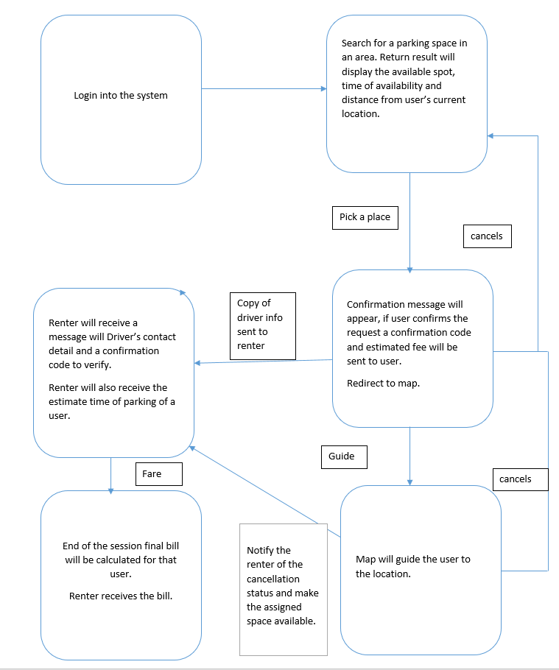
Process of handling a request

Slide 7
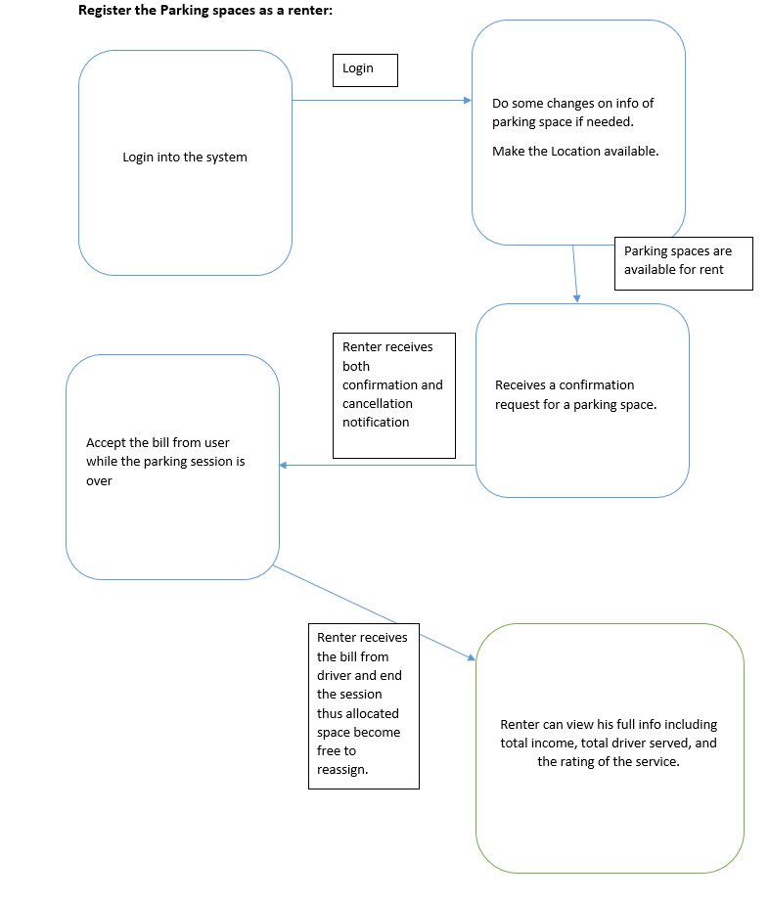

Slide 8
Any Question !!

Slide 9
Thank YOU.

